Slide 1
Preliminary Volumes assuming one reservoir for formerly Main Gas Sand and Oil Sand
Sand | Zones | BulkVolume [*10E6m^3] | Net Volume [*10E6m3] | STOIIP [*10E6Barrels] | GIIP [*10E9ft^3]
C 1.1 | Main Gas Sand | 253.07 | 228 | 63 | 535
C1.2 | ratty sand (Gas) | 112.40 | 34 | 8 | 43
 | shale | 42.93 | 0 | 0 | 0
C2.1 | Gas and Oil Sand | 18.92 | 17 | 10 | 37
C2.2 | ratty sand (Oil) | 1.76 | 1 | 1 | 0
C2.3 | Oil Sand | 0.00 | 0 | 0 | 0

Slide 2
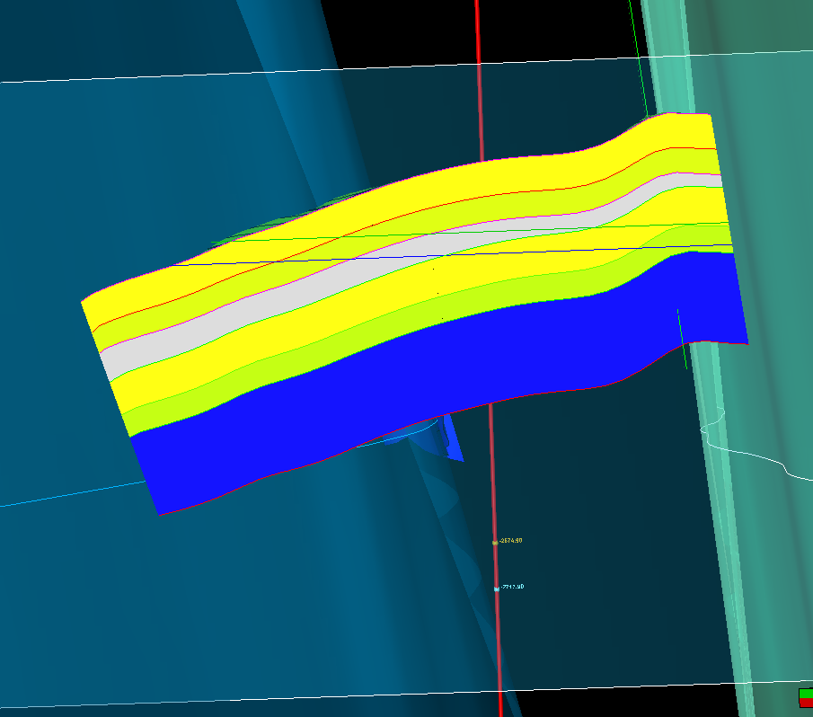
Cross section
Good MGS
Ratty Sand
Shale
Good OS sand
Ratty OS sand
Water bearing sand
GOC
OWC

Slide 3
